Slide 1
Web Development:
Animations with Javascript

Slide 2
Recap: Dynamic
Adding Javascript to web pages makes them dynamic.
Dynamic websites change and respond to user input, allow for interactivity, and data storage.
Notes:
As we learned in previous lessons, adding JS to web pages helps to make them more dynamic. Dynamic websites change and respond to user input, and allow for interactivity.

Slide 3
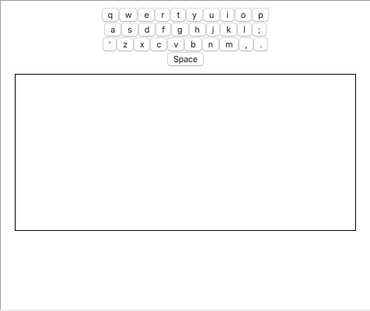
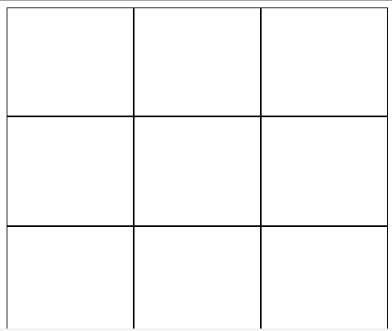
Recap: Dynamic
Button Interactions
Keyboard Interactions
Notes:
So far, we've been making sites more dynamic by adding button and keyboard interactions.

Slide 4
Recap: Dynamic
Button Interactions
Keyboard Interactions
Notes:
With buttons, users can now click on our sites and control how pages act.

Slide 5
Recap: Dynamic
Button Interactions
Keyboard Interactions
Notes:
And they can now make changes uses the keyboard.

Slide 6
Animations
Another way of increasing interactivity is through animations!
Notes:
Another way that we can create interactivity and dynamism is through animations!

Slide 7
Animations
Animations are gradual changes to an elements style:
Notes:
Animations are gradual changes to an elements style that make them appear to move, or animate.

Slide 8
Animations
Animations are gradual changes to an elements style:
Notes:
By making incremental changes, to style, such as width and height, we can make objects appear to grow.

Slide 9
Animations
Animations are gradual changes to an elements style:
Notes:
and grow! The smaller and faster that those changes occur, the more seamless the animations will look.

Slide 10
setInterval
We can make gradual changes to element style using the setInterval function.
Notes:
We can make gradual changes to the style of an element using the setInterval function in JS.

Slide 11
setInterval
setInterval allows us to call a function repeatedly over a set interval:
setInterval(myFunction, interval)
Notes:
setInterval allows us to call a function repeatedly over a set interval. Here we have an example of how setInterval could be called in a program.

Slide 12
setInterval
setInterval allows us to call a function repeatedly over a set interval:
setInterval(myFunction, interval)
Function we want to call
Notes:
In each setInterval call, we need to specify a function that we want called on repeat.

Slide 13
setInterval
setInterval allows us to call a function repeatedly over a set interval:
setInterval(myFunction, interval)
How often we want to call our function
Notes:
and how often we want to call that function.

Slide 14
setInterval
setInterval allows us to call a function repeatedly over a set interval:
setInterval(myFunction, 500)
The value is in milliseconds.
Notes:
The value that we place in the interval is a value in milliseconds - 1000 milliseconds is equivalent to one second, so in this example, the function myFunction will be called every half second.

Slide 15
Animations
setInterval allows us to call a function repeatedly over a set interval:
setInterval(grow, 500)
Notes:
If we wanted our square to grow gradually over time, we could create a setInterval timer that would call a function, grow, every 500 milliseconds.

Slide 16
Animations
setInterval allows us to call a function repeatedly over a set interval:
setInterval(grow, 500)
Notes:
When the program gets to the line of code with setInterval, the timer will call the grow function, and expand the size of the square.

Slide 17
Animations
setInterval allows us to call a function repeatedly over a set interval:
setInterval will continue indefinitely!
setInterval(grow, 500)
Notes:
However, every 500 milliseconds, the grow function will be called. setInterval only specifies how often the function is called, and will continue indefinitely.

Slide 18
Animations
setInterval allows us to call a function repeatedly over a set interval:
setInterval will continue indefinitely!
setInterval(grow, 500)
Notes:
Our square will continue to grow

Slide 19
Animations
setInterval allows us to call a function repeatedly over a set interval:
setInterval will continue indefinitely!
setInterval(grow, 500)
Notes:
and grow

Slide 20
Animations
setInterval allows us to call a function repeatedly over a set interval:
setInterval will continue indefinitely!
setInterval(grow, 500)
Notes:
and grow endlessly! So how can we get this to stop when we think it's big enough?

Slide 21
clearInterval
We can terminate setInterval by using the function clearInterval.
Notes:
We can terminate the setInterval function by using the function clearInterval.

Slide 22
clearInterval
clearInterval halts the execution of a timer:
clearInterval(setIntervalId)
Notes:
clearInterval halts the execution of a timer.

Slide 23
clearInterval
clearInterval halts the execution of a timer:
clearInterval(setIntervalId)
The function that we want to stop!
Notes:
clearInterval accepts one parameter, which is the ID of an existing setInterval.

Slide 24
setInterval ID
setInterval returns an ID that allows clearInterval to identify which timer to stop:
Notes:
setInterval actually returns an ID when it is called that allows clearInterval to identify which timer we want to stop.

Slide 25
setInterval ID
setInterval returns an ID that allows clearInterval to identify which timer to stop:
var timer = setInterval(grow, 500)
We can set a variable equal to our setInterval to store the unique ID of that timer!
Notes:
We can actually set a variable equal to our setInterval call. That variable now will store the unique ID of the timer.

Slide 26
setInterval ID
setInterval returns an ID that allows clearInterval to identify which timer to stop:
var timer = setInterval(grow, 500)
When we call clearInterval, we specify the interval using the variable we used to store its ID
clearInterval(timer)
Notes:
When clearInterval is called, we can pass it the variable timer that we just created. This specifies the exact timer that we would like to stop, and the timer will stop once the clear interval is called.

Slide 27
setInterval ID
setInterval returns an ID that allows clearInterval to identify which timer to stop:
var timer = setInterval(grow, 500)
If we ran this as is, nothing would happen!
clearInterval(timer)
Notes:
If we were to run this program as is, nothing would happen. This is because clearInterval would be called immediately after setInterval, which halts the program from occurring.

Slide 28
setInterval ID
setInterval returns an ID that allows clearInterval to identify which timer to stop:
var timer = setInterval(grow, 500)
clearInterval often lives in a conditional statement
if(size == desiredSize)
{
clearInterval(timer)
}
Notes:
Typically, clearInterval lives inside a boolean expression to halt the timer when the style of the element fits the desired criteria. In our case, we want our square to grow to be a specific size. Once it reaches that, we want the timer to then halt.

Slide 29
Now it's Your Turn!
Notes:
Now that you've learned about intervals and animations, let's give it a try.

Slide 30
Animations | A gradual change in an elements style that occurs over time, and makes it appear that an element is animated.
setInterval(myFunction, interval) | A function that repeats the function myFunction every interval interval indefinitely. This function returns a unique ID that can be used to identify the timer.
clearInterval(setIntervalID) | A function that takes a setInterval timer ID, and halts that function from executing.

